Slide 1
TRAFFIC SIGN DETECTION
1602-21-737-012 S. Bagawan Reddy
1602-21-737-045 P. Sai Charan

Slide 2
AGENDA
1.PROBLEM STATEMENT
2.ABSTRACT
3.LITERATURE STUDY
4.IMPLEMENTATION
5.RESULTS OBTAINED

Slide 3
1.PROBLEM STATEMENT
Developing and optimizing a Convolutional Neural Network (CNN) model for traffic sign detection on arbitrary images generated in the referenced study.

Slide 4
2.ABSTRACT
The research focuses on improving CNN performance for traffic sign detection.
It builds on a previous study that introduced synthetic image generation methods for this application.
The original model achieved moderate accuracy in detecting traffic signs but had room for improvement in precision, reliability, and computational efficiency.
This work aims to enhance performance by using lightweight architectures optimized to improve generalization to real-world traffic signs while reducing computational time.
The objective is to decrease computational time, contributing to safer and more efficient traffic sign detection systems.

Slide 5
3. LITERATURE STUDY
PAPER 1:
Effortless Deep Training for Traffic Sign Detection Using Templates and Arbitrary Natural Images
SUMMARY:
The paper tackles the challenge of training deep learning models for traffic sign detection without relying on annotated real-world datasets.
Real-world datasets are expensive and time-consuming to collect and annotate.
To address this, the authors developed a synthetic data generation method.
This method combines natural images with traffic sign templates to create an effective training set.
The approach helps overcome issues such as data imbalance and the costly annotation process.

Slide 6
Outcome | Description | Performance Metrics
Synthetic Data Generation | Created synthetic images by overlaying traffic sign templates on arbitrary natural backgrounds, reducing data cost and annotation efforts. | Eliminates need for real-world data
Detection Accuracy | Model trained on synthetic data achieved strong performance in detecting traffic signs. | Achieved > 95% mean Average Precision (mAP)
Evaluation on German Traffic Signs | Evaluated on the German Traffic Sign Detection Benchmark (GTSDB) | Precision: 94%, Recall: 91%, F1-Score: 93%
SOURCE:
DOI: 10.1109/IJCNN.2019.8852086

Slide 7
PAPER 2:
Enhancing Traffic Sign Detection and Classification Using Multi-Task Learning with CNNs
SUMMARY:
The problem identified in this study focuses on improving the performance of Traffic Sign Recognition (TSR) systems.
TSR systems' performance is affected by adverse weather conditions and environmental changes, which impact the accuracy of autonomous vehicles.
The authors selected this problem to leverage Convolutional Neural Networks (CNNs) and the German Traffic Sign Recognition Benchmark (GTSRB) dataset.
The aim is to enhance the robustness and accuracy of detection models for real-world autonomous driving and assistance systems.

Slide 8
Outcome | Description | Performance Metrics
CNN Architecture Design | Built a CNN with multiple convolutional and pooling layers, optimized using the Adam optimizer for effective feature extraction. | Classification accuracy: 98%
Dataset | Model trained on the German Traffic Sign Recognition Benchmark (GTSRB) | Dataset size: 50,000+ images, 43 classes
Model Performance | Achieved high accuracy suitable for autonomous driving and intelligent traffic systems applications. | Recognition accuracy: > 98%
SOURCE:
DOI: 10.1109/ICCST59048.2023.10474262

Slide 9
PAPER 3:
Deep Learning for Large-Scale Traffic-Sign Detection and Recognition
SUMMARY:
The paper focuses on the need for large-scale traffic-sign detection for inventory management.
Most existing models are limited to detecting a small set of categories relevant to autonomous driving.
The study identifies a gap in handling high intra-category variability.
It proposes using Mask R-CNN to build a system that can detect and recognize a broad range of traffic signs across different conditions.

Slide 10
Outcome | Description | Performance Metrics
Handling Real-World Conditions | Addressed challenges like lighting, weather variations, and image distortions for robust traffic sign detection. | Limitations in generalization and overfitting
Generalization Improvements | Applied strategies including deeper architectures, data augmentation, and regularization for enhanced robustness. | Improved robustness and efficiency under diverse conditions
Deeper Architectures for Accuracy | Demonstrated improved detection accuracy with deep architectures, critical for safety in traffic sign detection. | Achieved lower error rates, < 3% overall
SOURCE:
DOI: 10.1109/TITS.2019.2913588

Slide 11
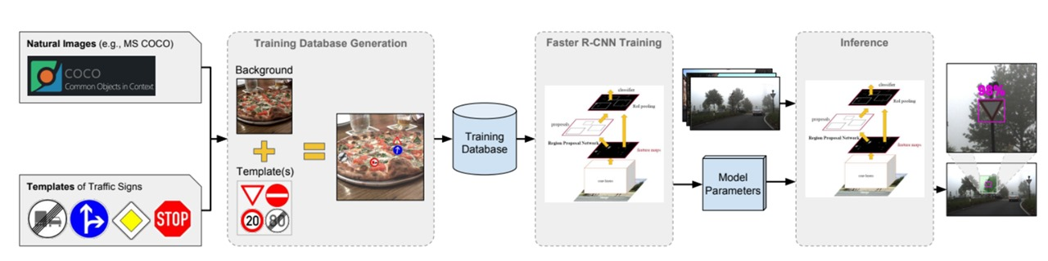
4.IMPLEMENTATION
4.1 BLOCK DIAGRAM

Slide 12
DATASETS
Arbitrary Natural Images Dataset
Source: https://github.com/LCAD-UFES/publications-tabelini-ijcnn-2019/tree/master
2. German Traffic Sign Detection Benchmark
Source: https://www.kaggle.com/datasets/safabouguezzi/german-traffic-sign-detection-benchmark-gtsdb

Slide 13
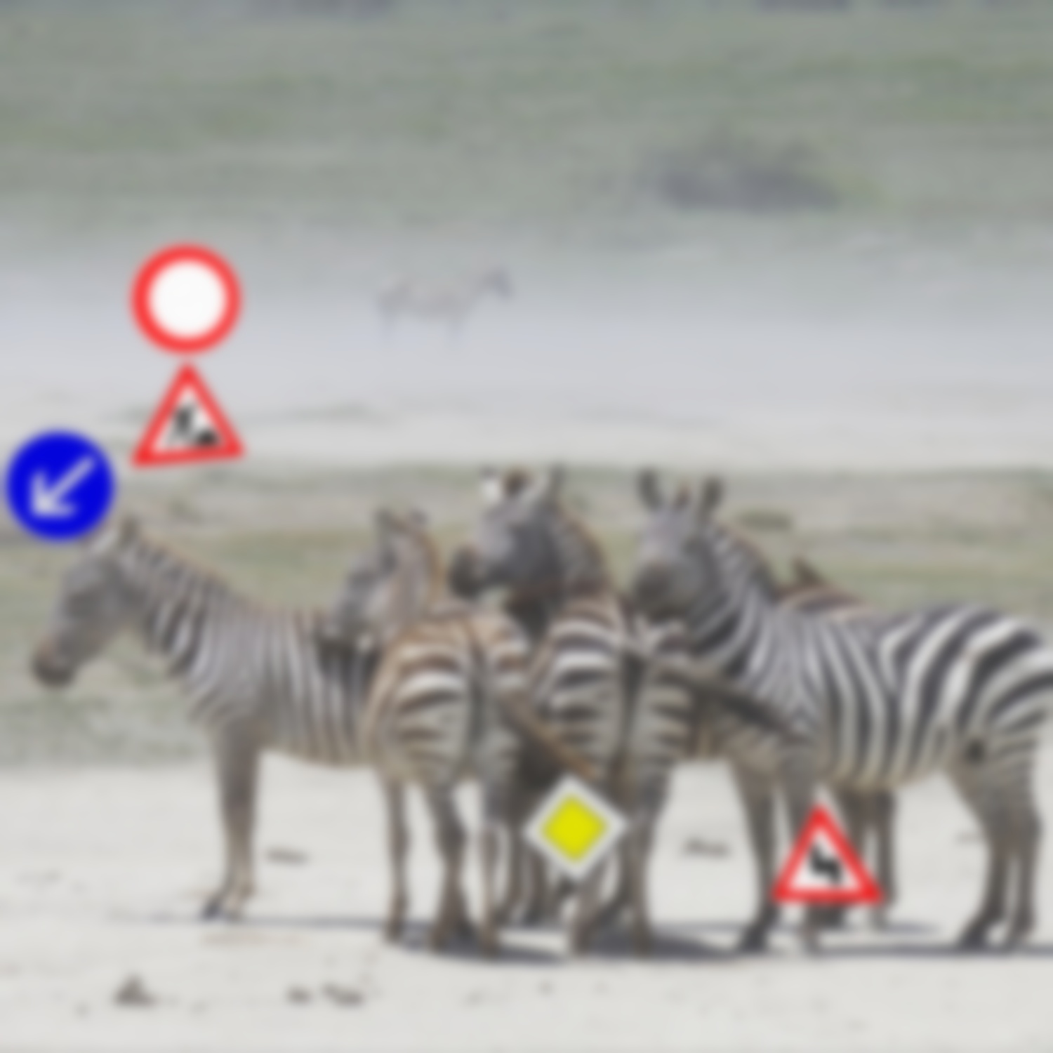
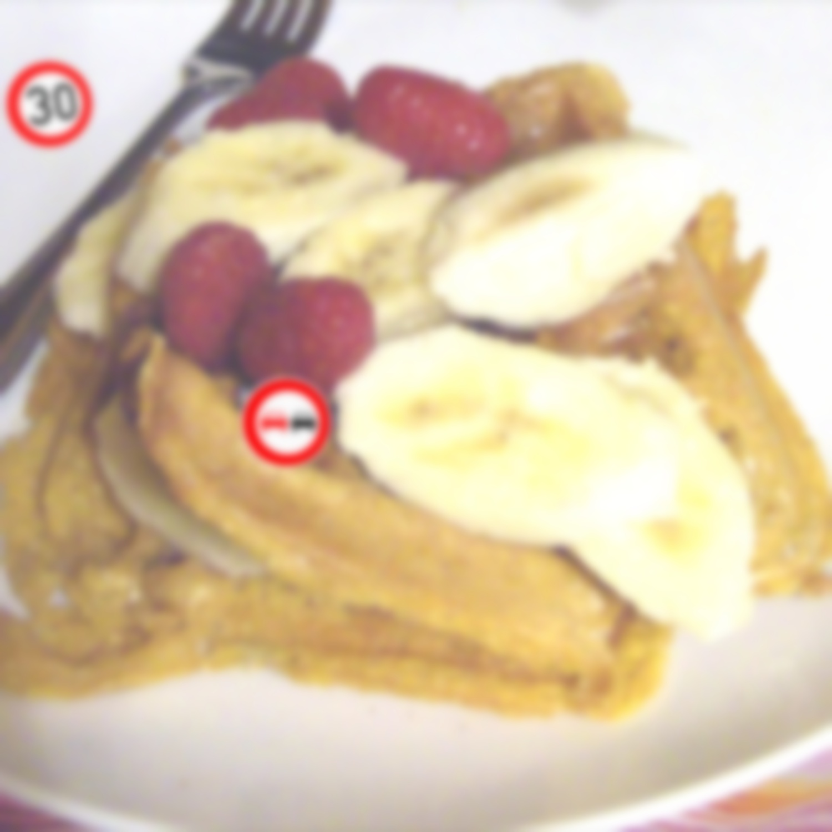
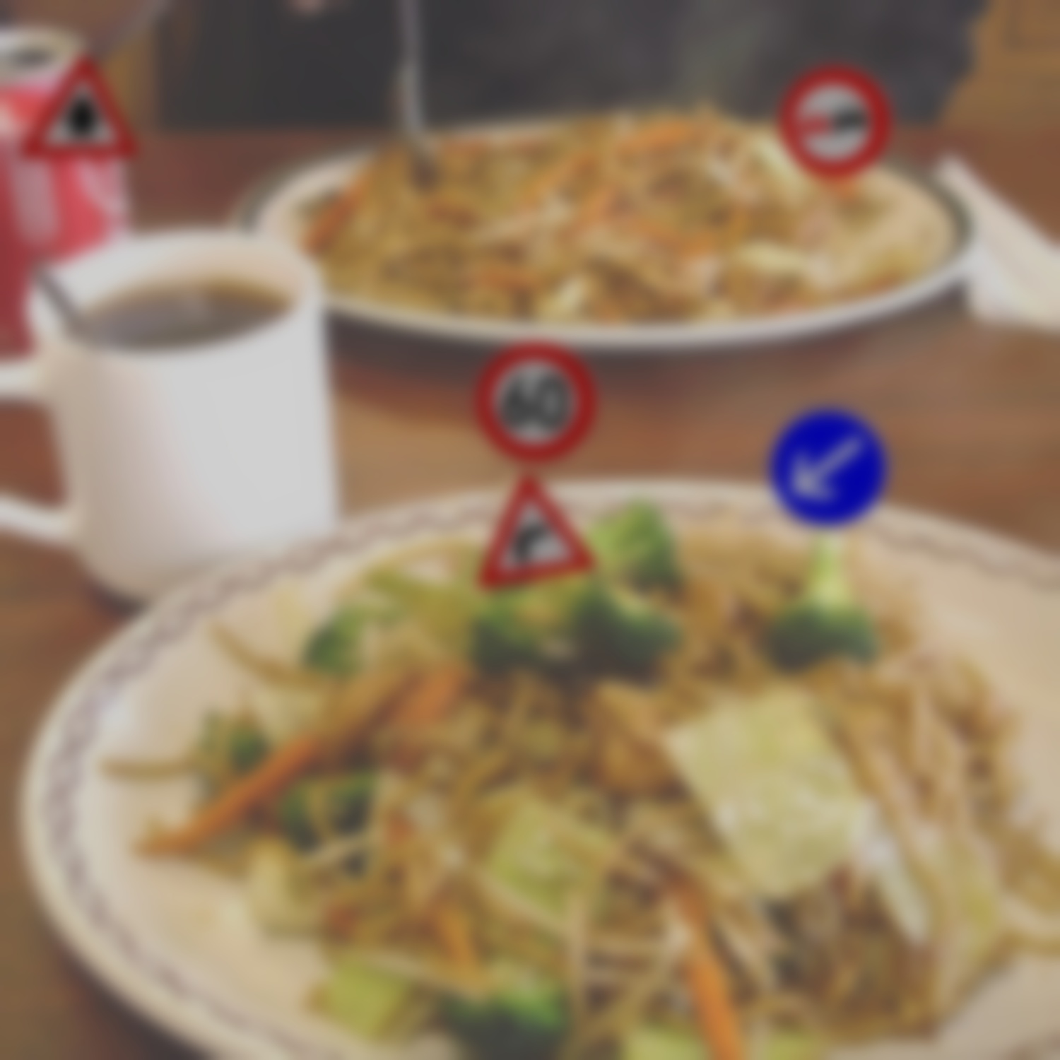
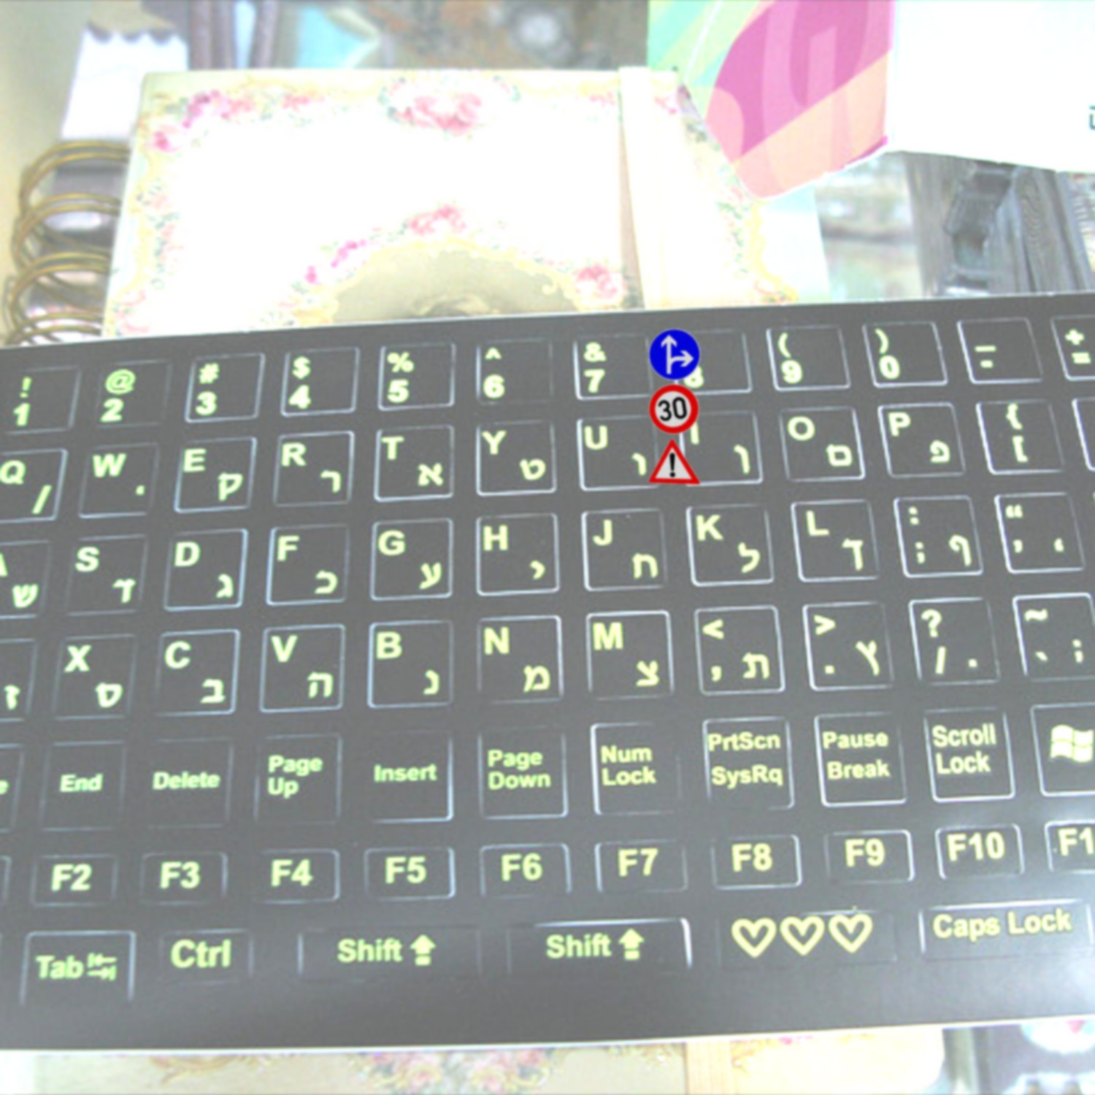
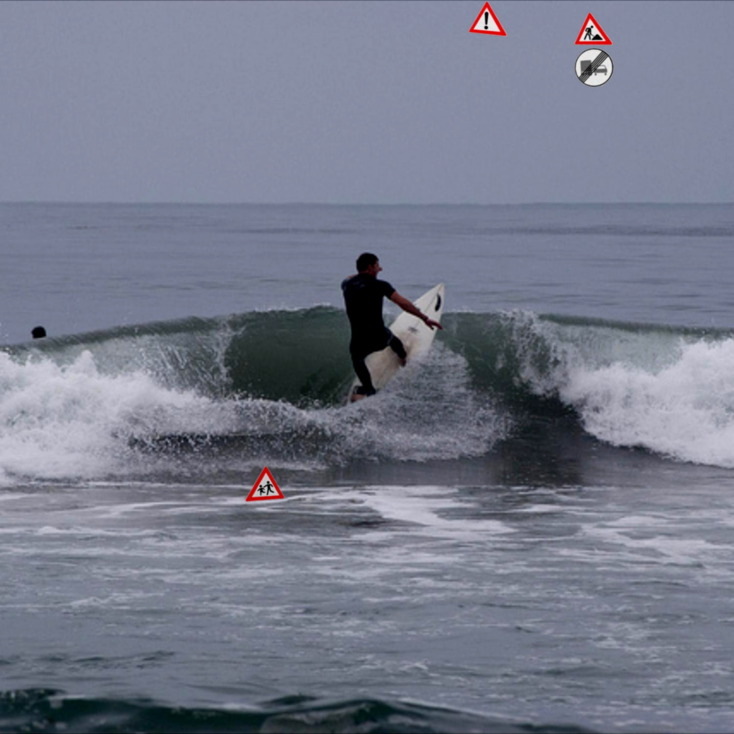
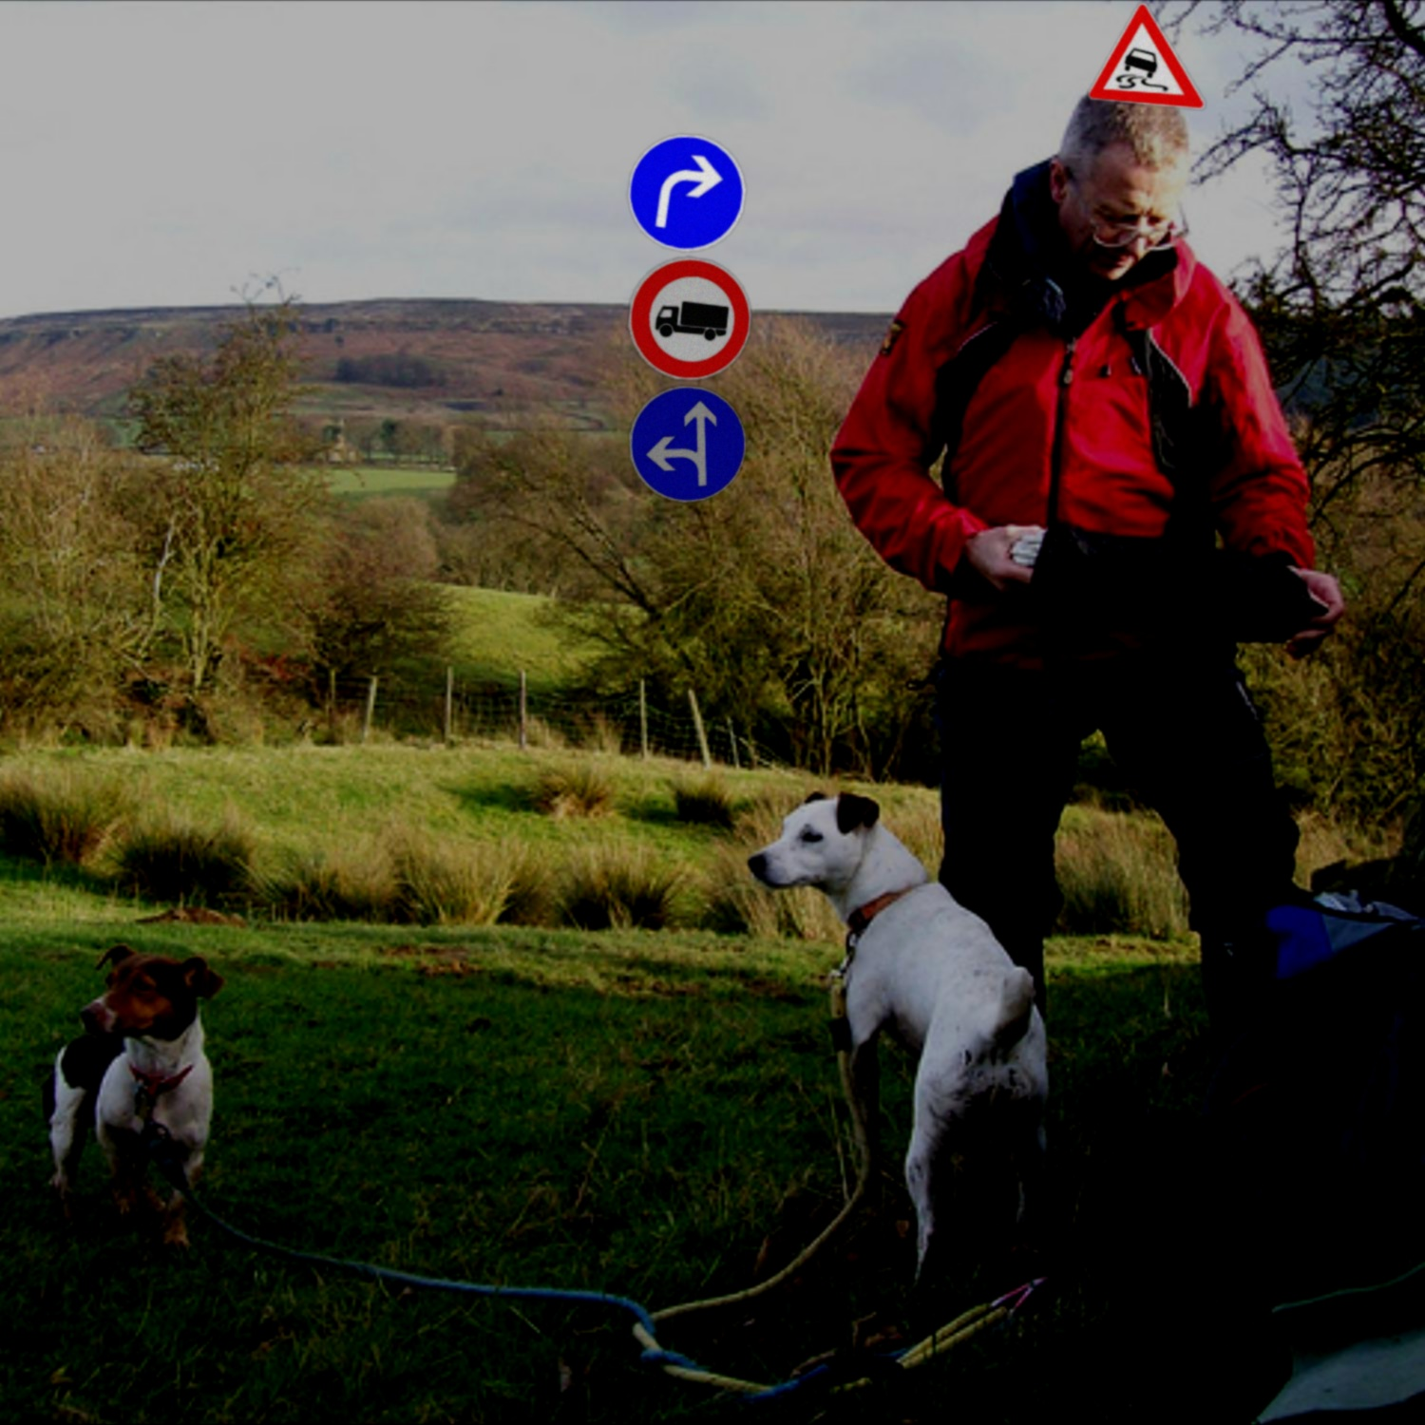
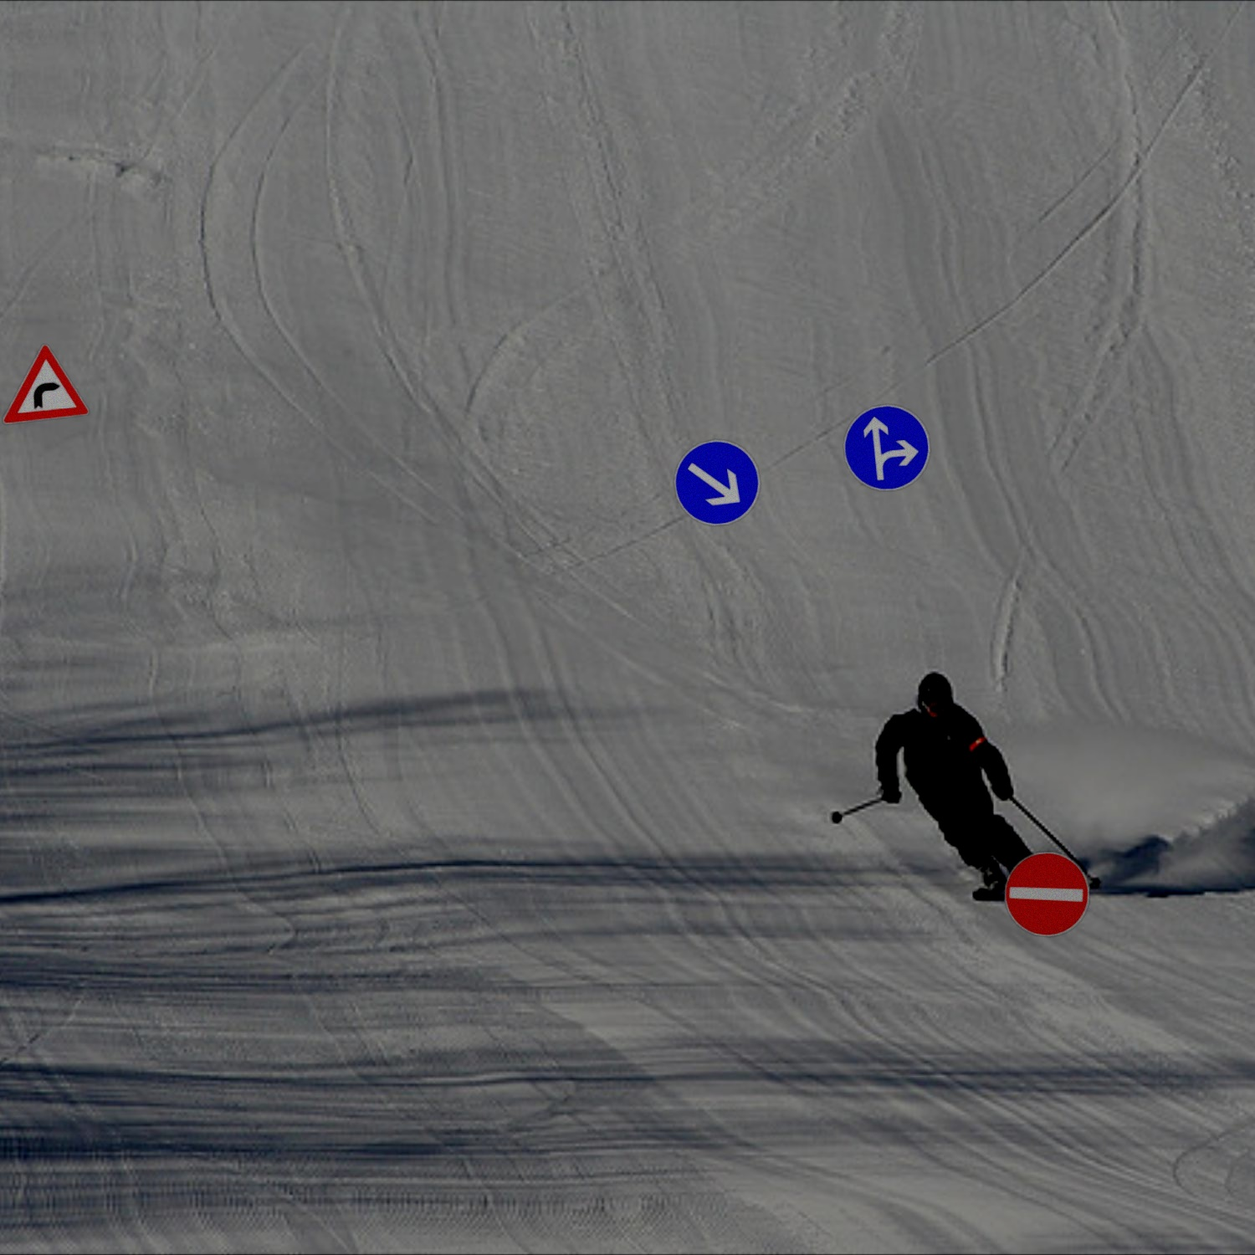
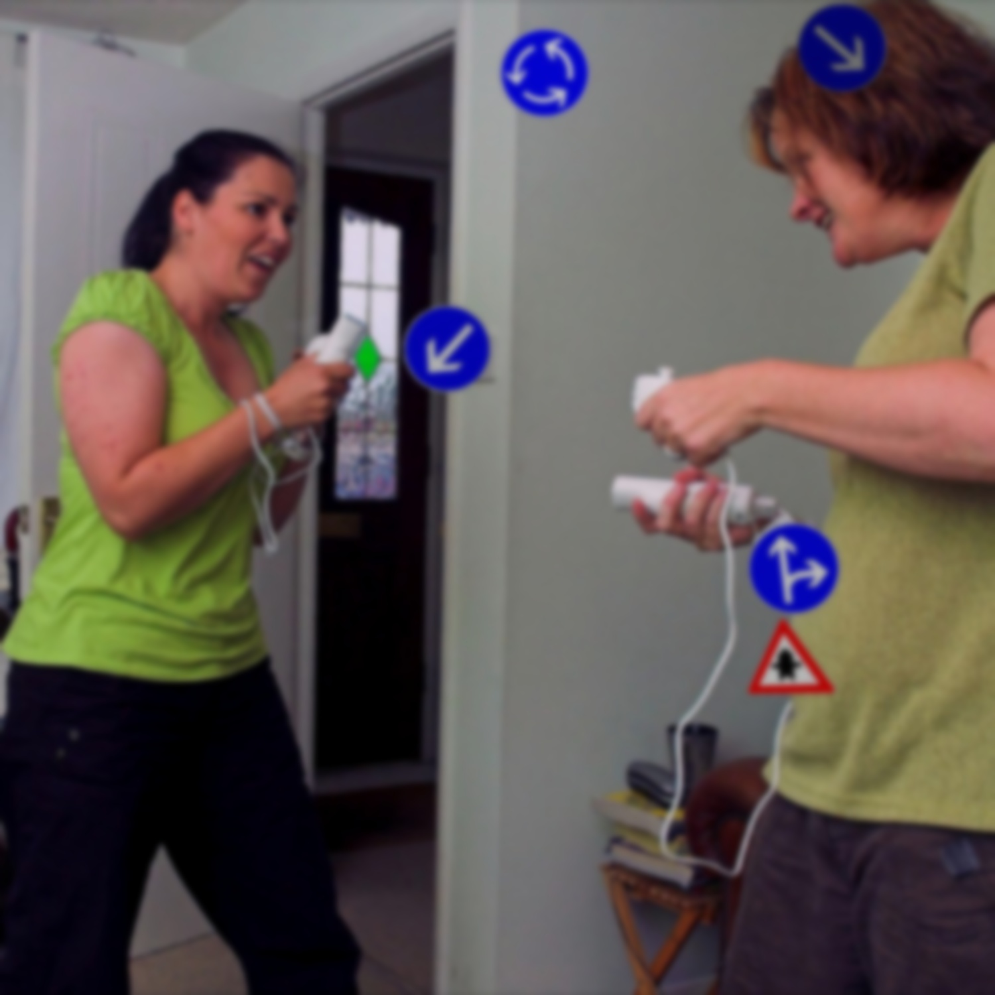
SAMPLE IMAGES

Slide 14
4.2 MODERN TOOLS:
HARDWARE REQUIREMENTS
GPU-enabled Machine: A machine with a powerful GPU (e.g., NVIDIA Tesla, RTX series) for training deep CNN models efficiently. GPUs significantly reduce training time compared to CPUs.
RAM: At least 16 GB to support efficient model training and data processing.
Storage: SSD with at least 512 GB for fast data access and model storage.
SOFTWARE REQUIREMENTS
Programming Language: Python, widely used for machine learning and deep learning with support for libraries like PyTorch.
Libraries:
OpenCV: For image preprocessing, such as resizing, transformations, and augmentations.
NumPy: For efficient numerical computations and handling large datasets

Slide 15
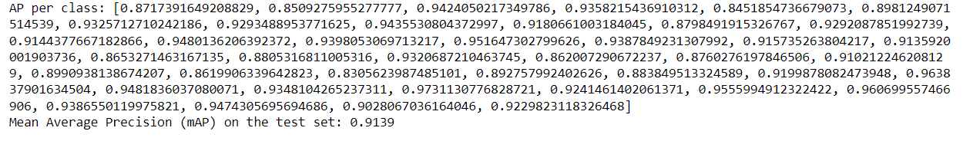
5.RESULTS
PRECISION

Slide 16
Category | Reasearch Paper | Experiment
Processor | Intel Xeon E5606 (2.13GHz), Intel Xeon E7-4850 v4 (2.10GHz) | Tesla V100-SXM2 GPU
GPU | NVIDIA TITAN Xp (12GB VRAM) | Tesla V100-SXM2 (2247MiB in use)
Compute Mode | TensorFlow (ResNet) | PyTorch(MobileNet-V2)
Training Duration | 7 hours on single run | 3 hours on single run
Table1: Comparison between research paper and our experiment

Slide 17
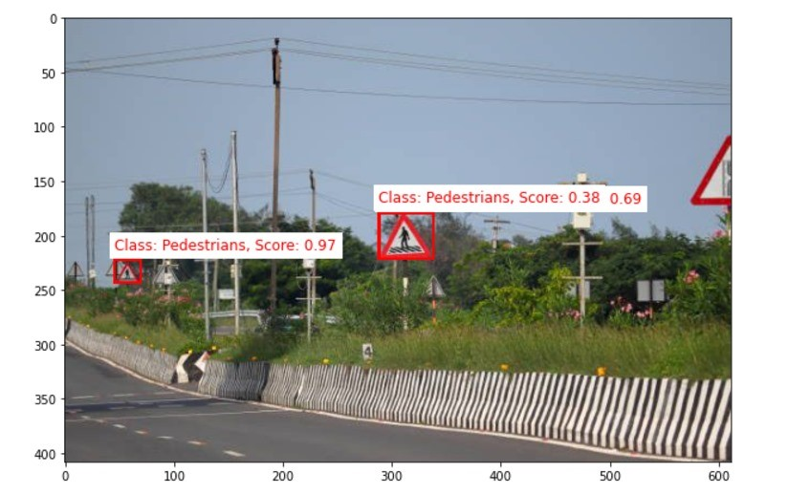
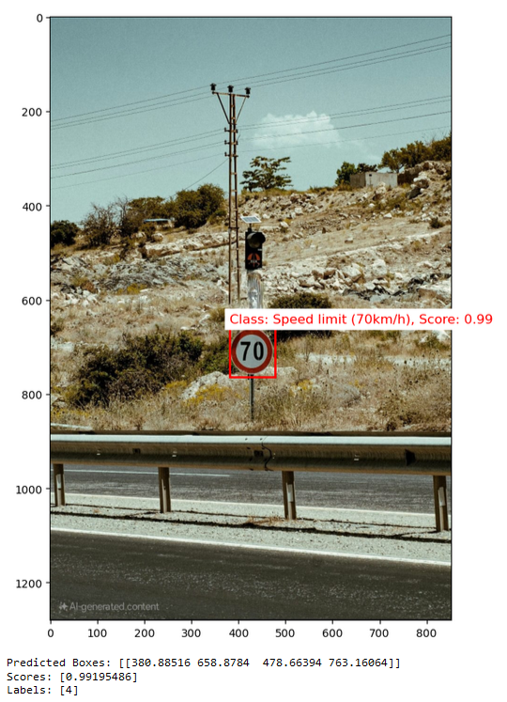
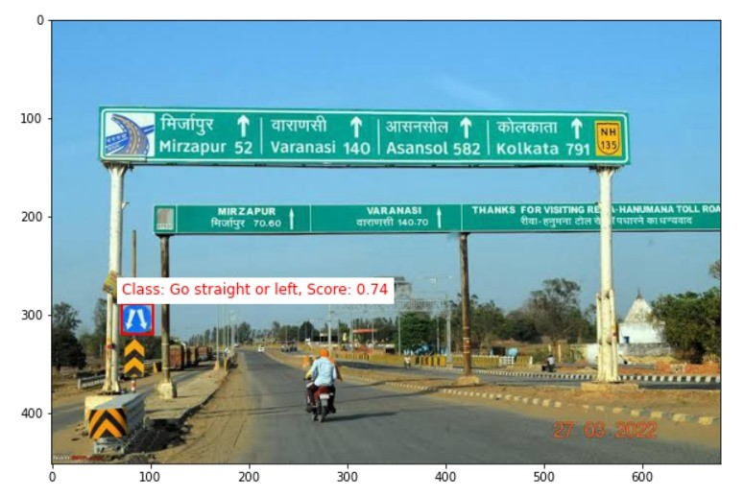

Slide 18
THANK YOU

